Slide 1
Illustrated Word

Slide 2
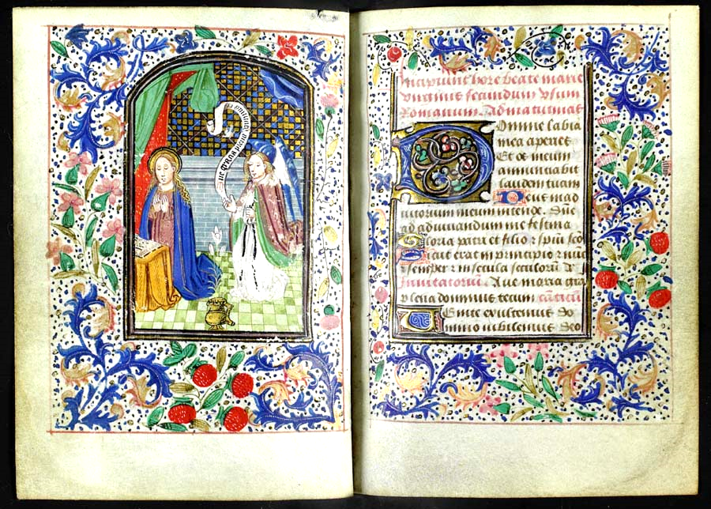
Illustrated Word
People have been decorating, or Illustrating, words for centuries.
Monks would illustrate bibles to help tell the stories and make the pages look more interesting.

Slide 3
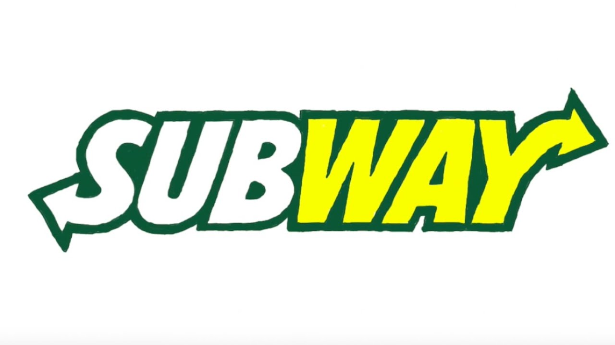
Words can be illustrated to create logos like the ones we just did.

Slide 4
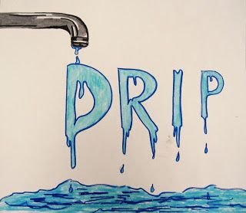
This week we will be taking a word and turning it into a visual image.

Slide 5
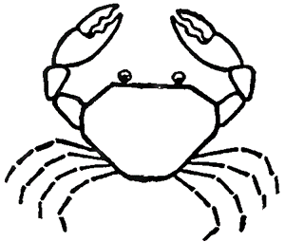
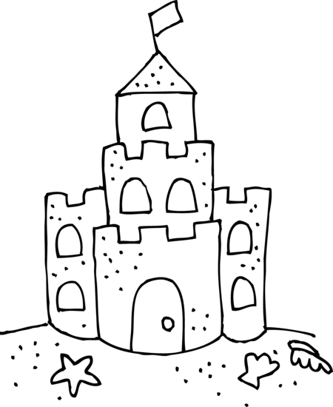
Brainstorming Process:
1.Think of a word
Write the word down
2. Make a list of at least 5 things associated with that word.
Write them below the word.
3. Think about how you could use the things from your list to illustrate the word.
4. Do little sketches of the illustrated word.
Beach
shells
water
sunglasses
umbrella
crab
towel
Pail & shovel
sandcastle
Bea c h
Beach

Slide 6
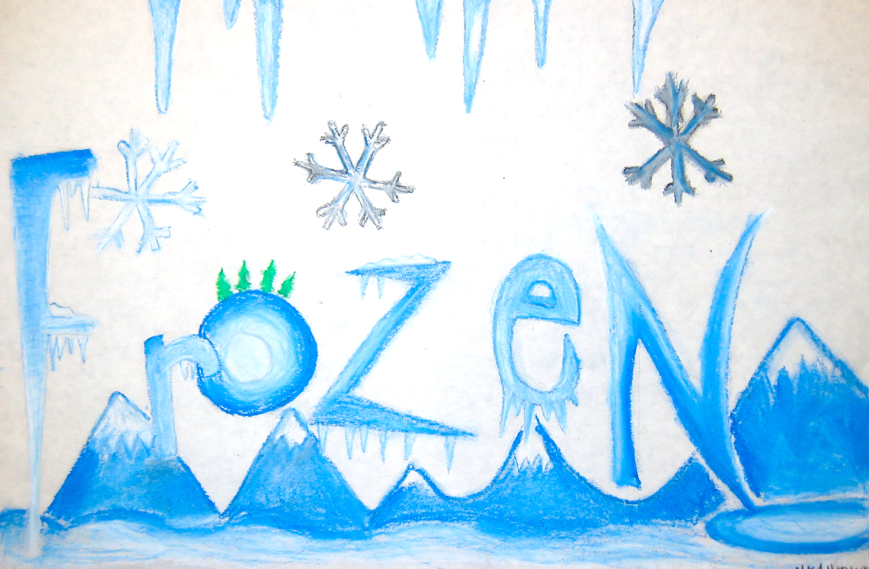
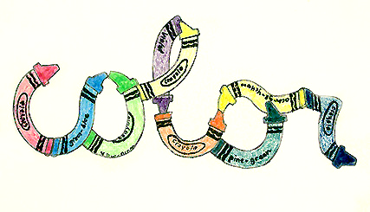
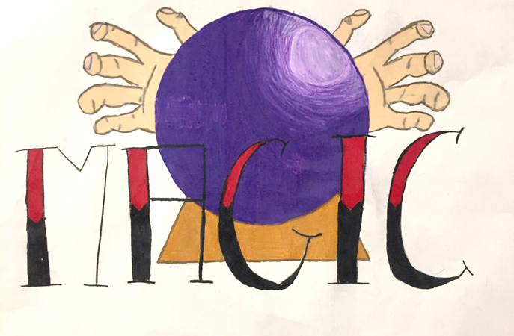
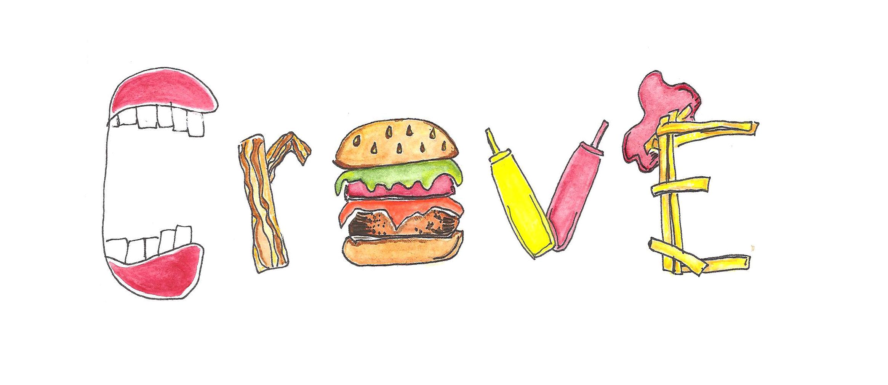
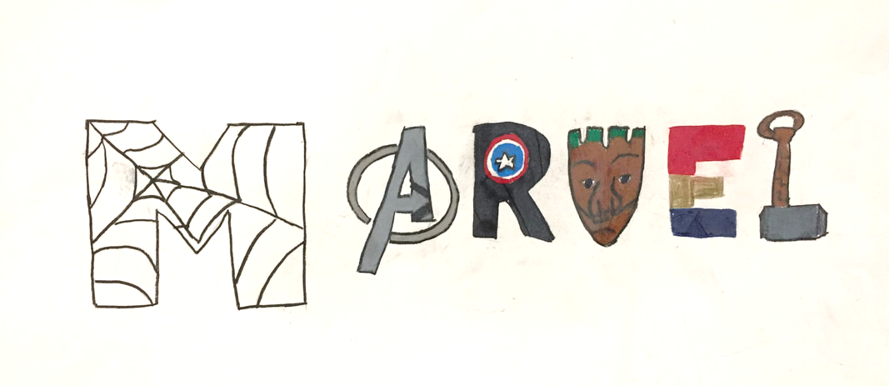
Make the word out of things related to the word, or put the word in the environment it would be in.
Use the objects from your list to form the letters,
or just write the word and draw those things from your list around it.

Slide 7
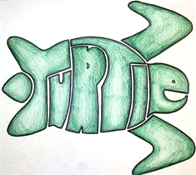
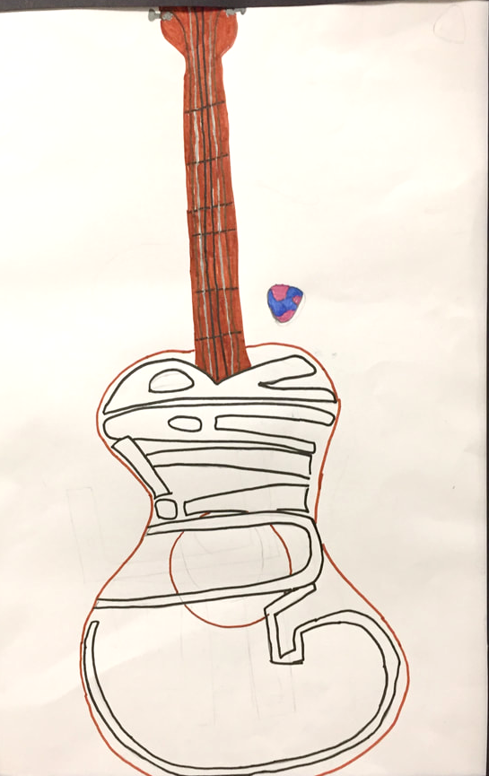
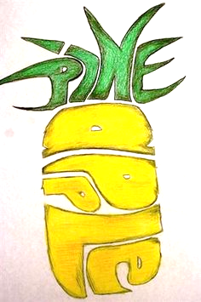
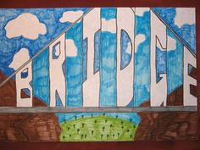
Make the word out of what the word is.
Draw the outline of the object and make the words fit inside to look like it.
Do you remember the TV show “Word World? click the link to watch the intro: Word World intro

Slide 8
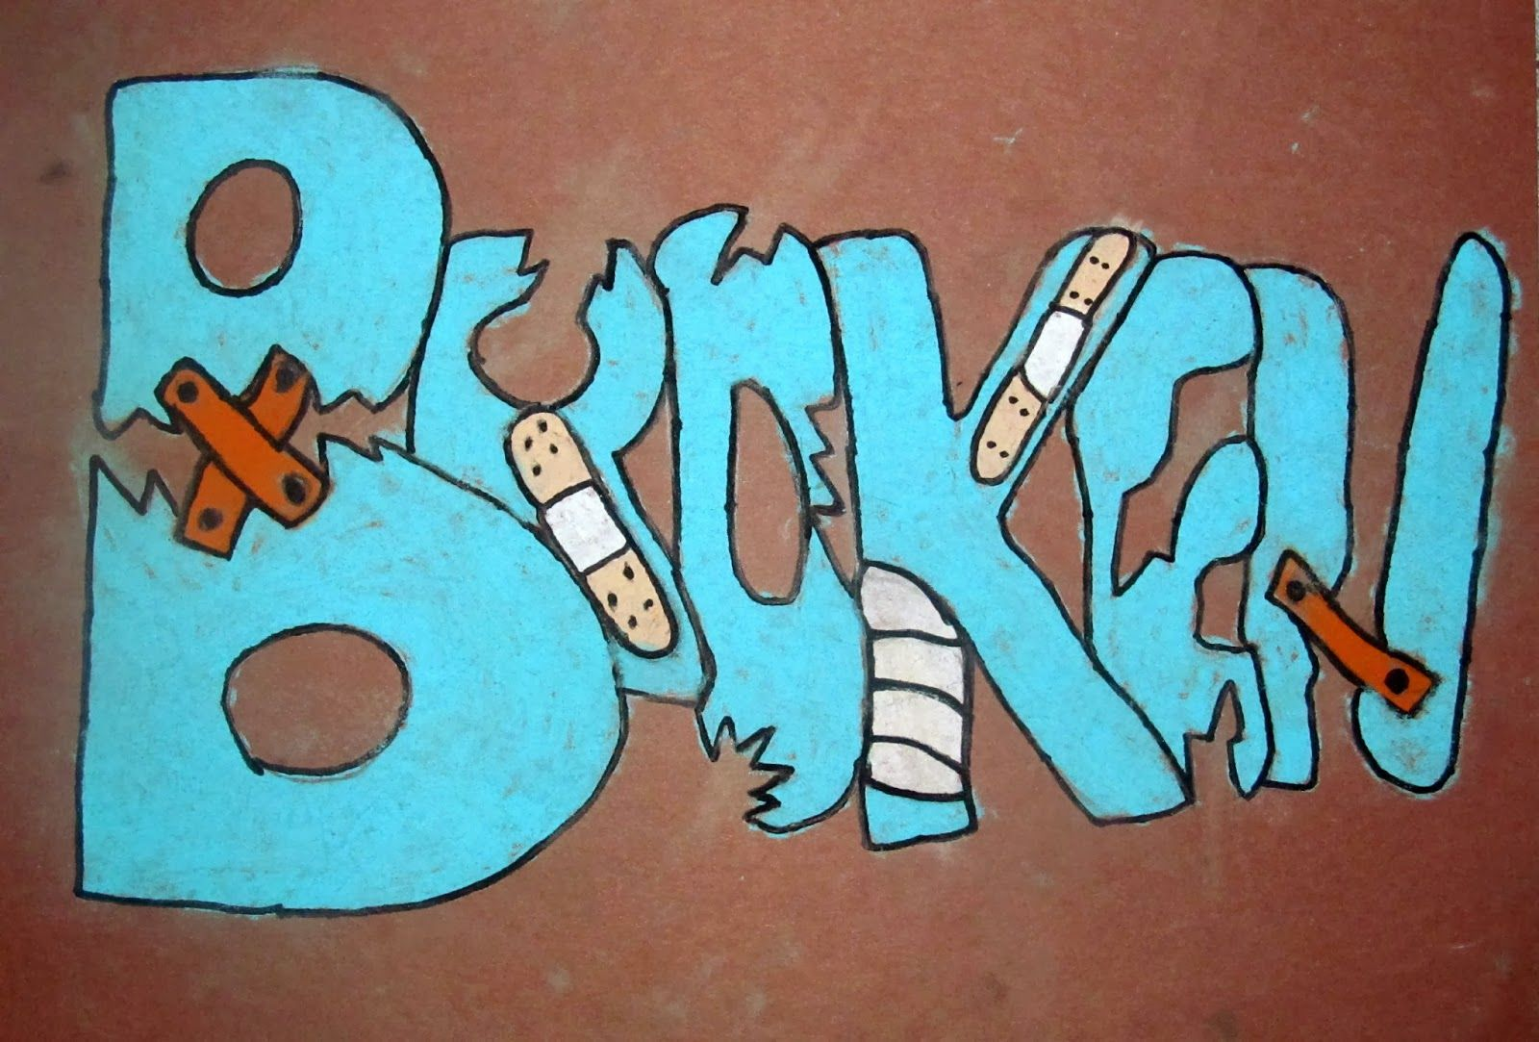
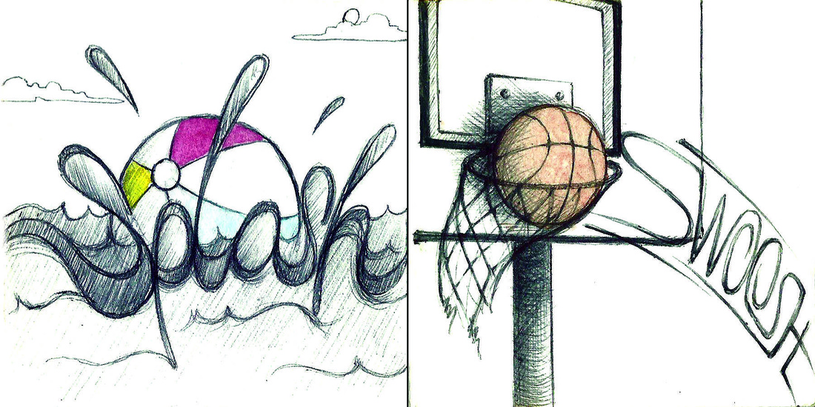
Make the word doing what the word says.
This works best with
verbs,
adjectives,
or onomatopoeia (look it up).

Slide 9
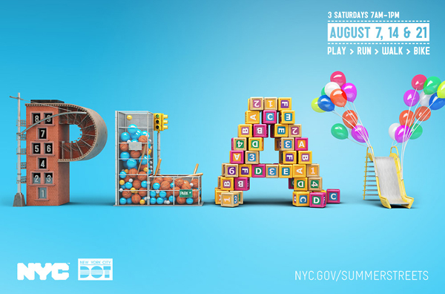
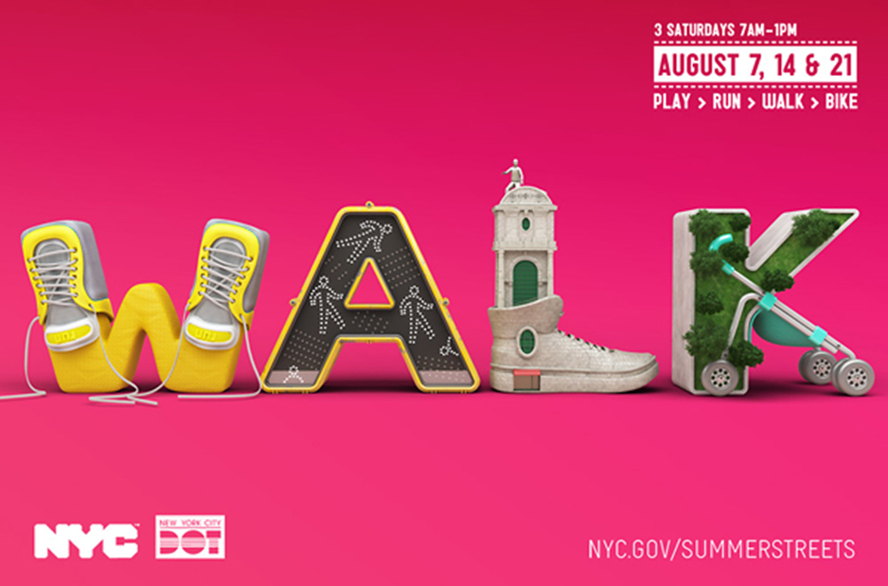
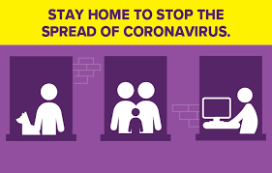
This is a series of posters New York City put out a few years ago to encourage people to get outside.
Ironically, here is a new one from NYC.gov to encourage people to stay home

Slide 10
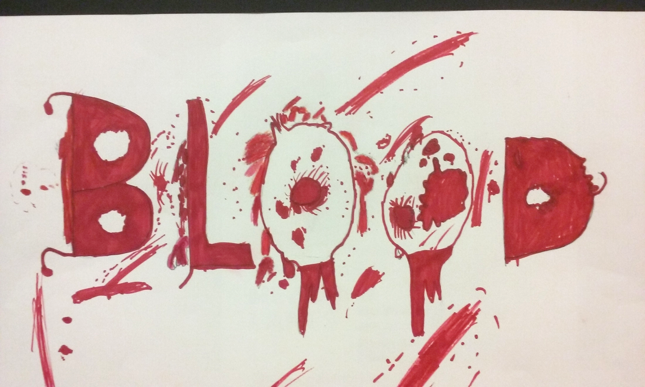
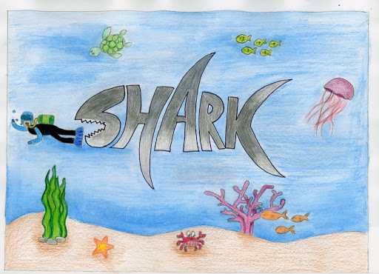
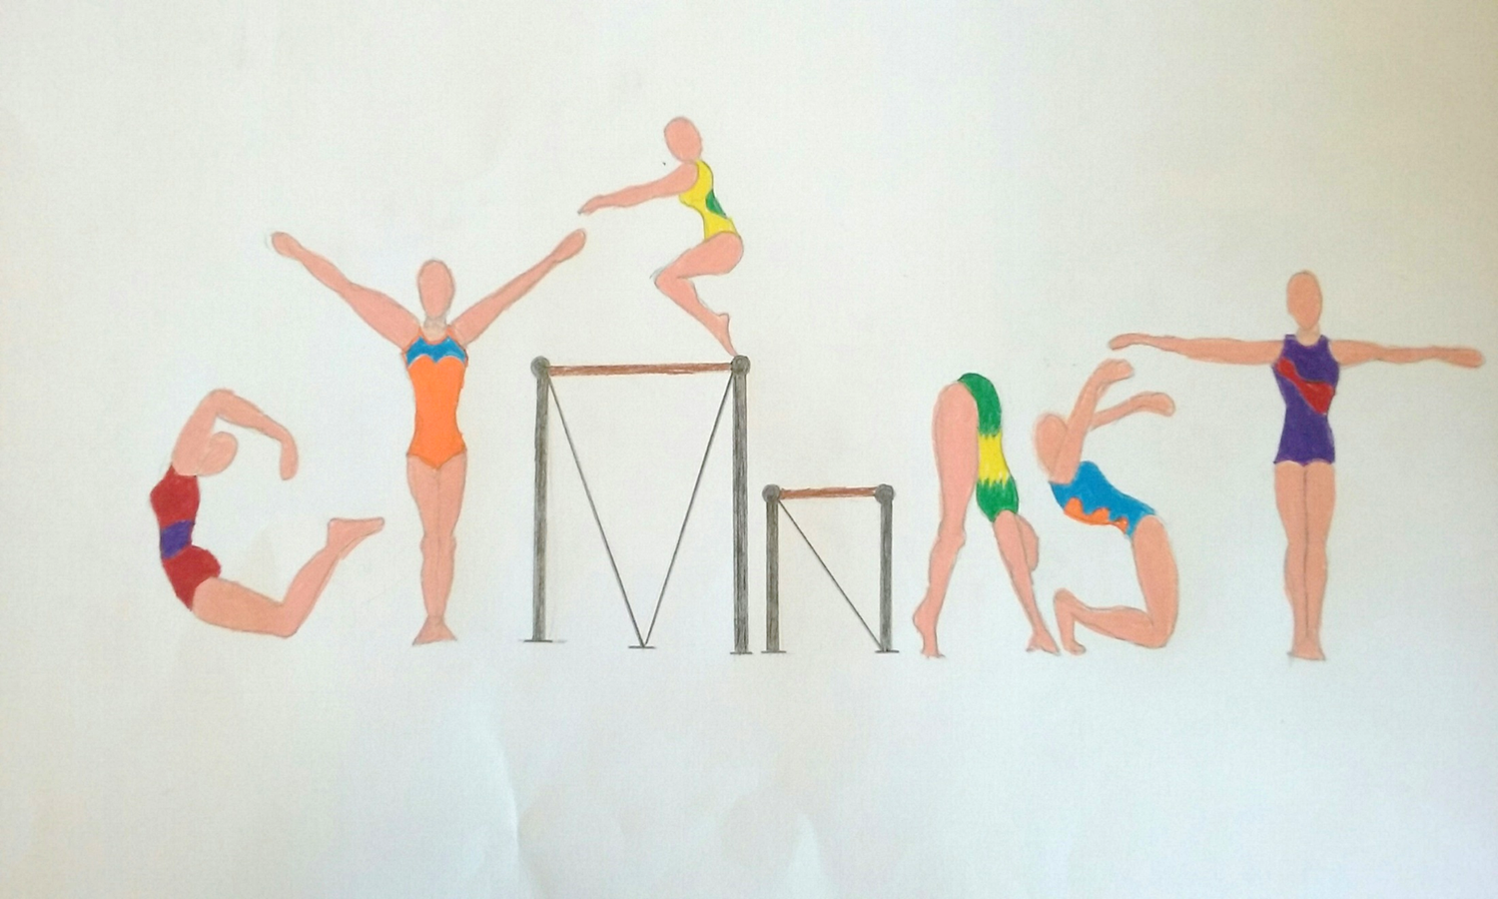
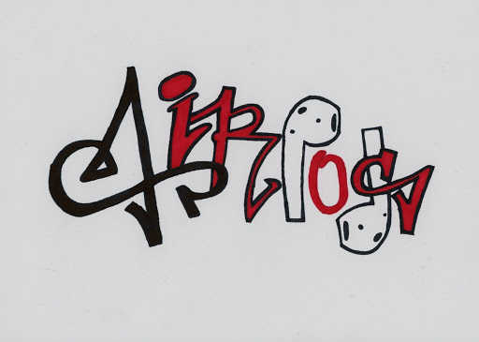
Just some examples:

Slide 11
Assignment:
Brainstorm at least 5 words.
-Write a list of things associated with your word.
2. Illustrate a few of your words in your sketchbook using your word list.
- Think about COMPOSITION.
- Look up reference images to draw from.
3. Choose your best word to transfer to the final copy.
-You can draw it lightly with pencil, then go over it with marker or colored pencil.
4. Take a GOOD photo, and attach it to the assignment to submit.

Slide 12
Your Illustrated Word project will be due on Wednesday April 29.
Until I see you in person:
Stay safe,
Wash your hands &
Keep drawing.
-Mr. G.

