Slide 1
OP Art
You took a “perception test.”
It was a fun way to show you that you can not always trust what you see!
We will be creating an OP Art project that is based on optical illusion.
Let’s learn a little about this style of art.

Slide 2
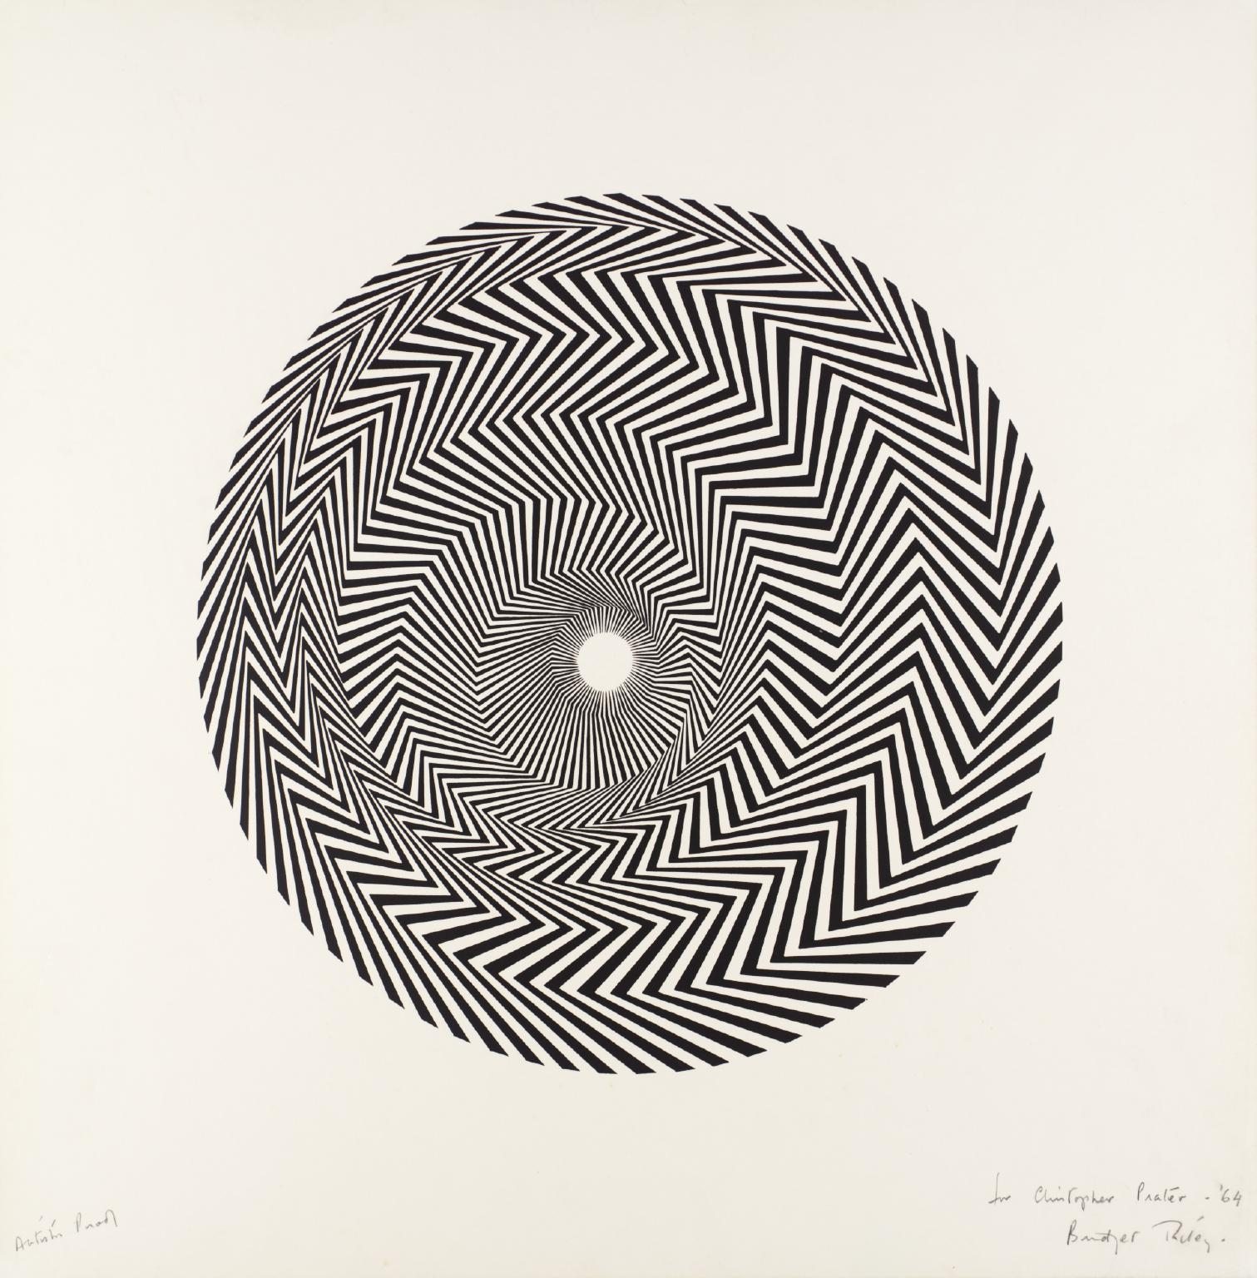
OP Art
Op art, short for optical art, is a style of visual art that uses optical illusions.
Op art works are abstract, with many better known pieces created in black and white. Typically, they give the viewer the impression of movement, hidden images, flashing and vibrating patterns, or of swelling or warping. They create Optical Illusions!

Slide 3
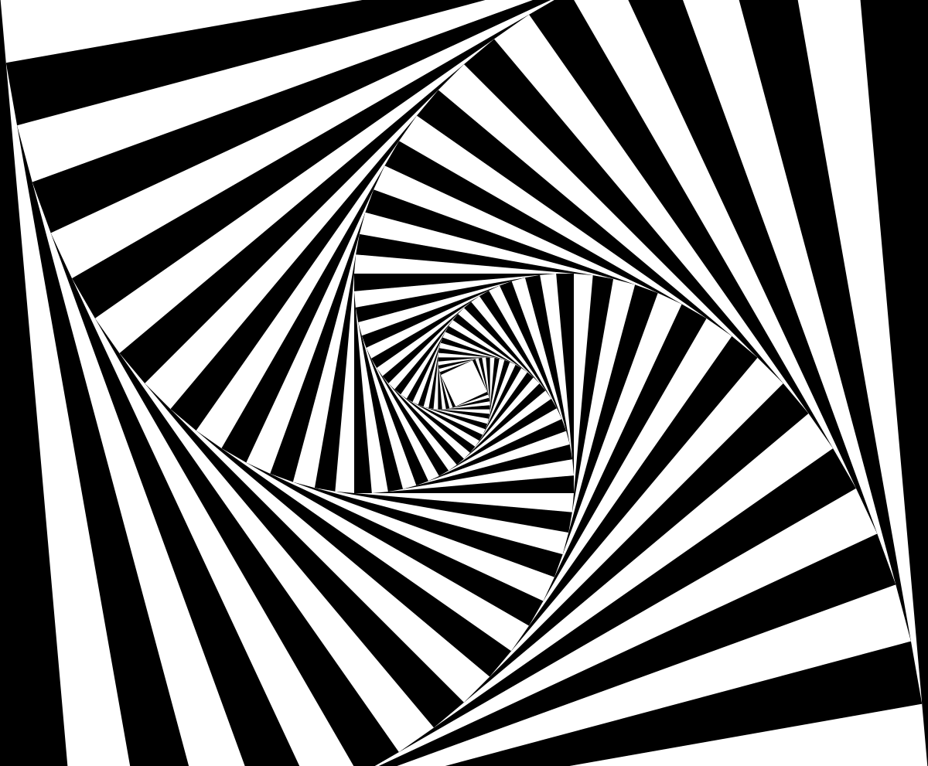
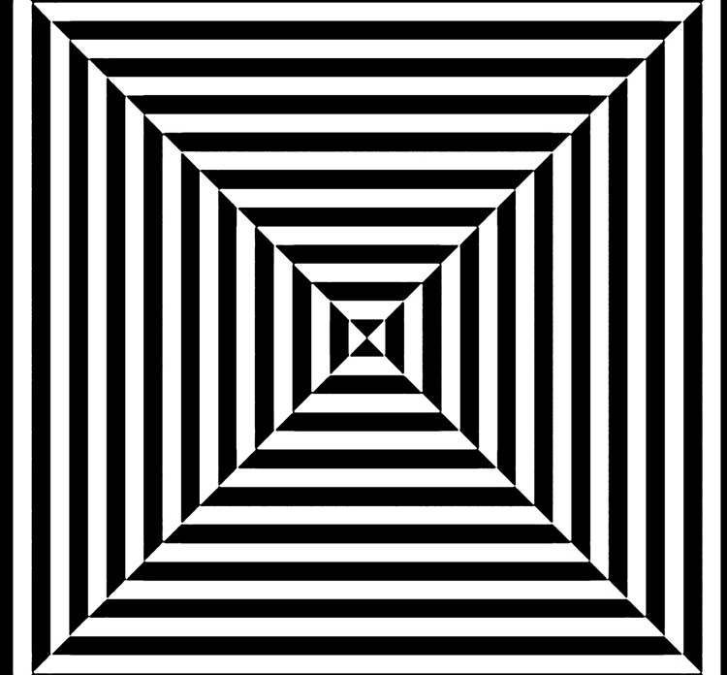
OP Art is also known as:
Geometric abstraction because it uses mostly geometric shapes
Hard-edge abstraction because the edges of the shapes are neat and clean.
Perceptual abstraction because it messes with the viewer’s perception.
Most popular in the 1960s, artists such as Victor Vasarely, Bridget Riley and M.C. Escher experimented with Optical Art.

Slide 4
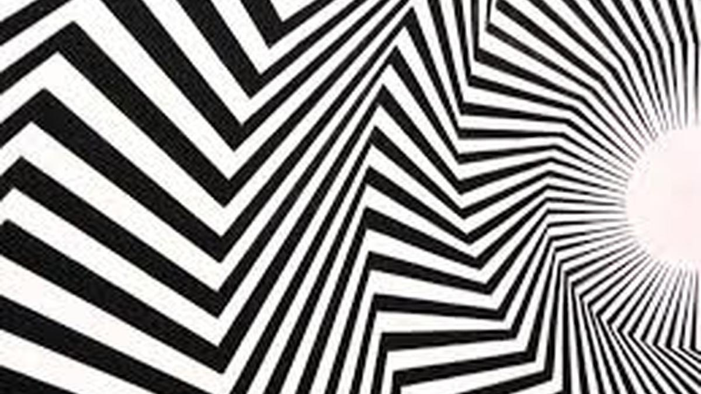
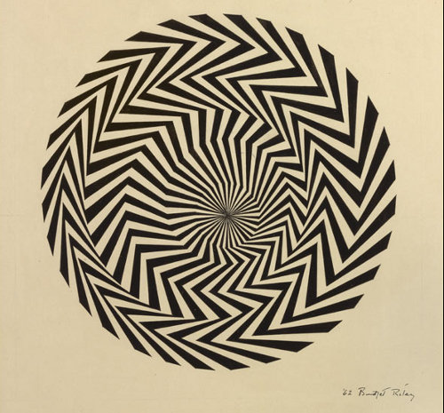
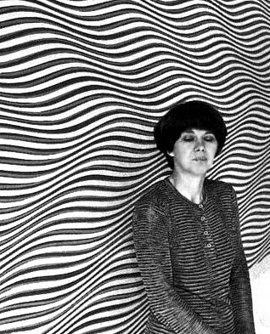
Bridget Riley
https://www.tate.org.uk/art/artists/bridget-riley-1845

Slide 5
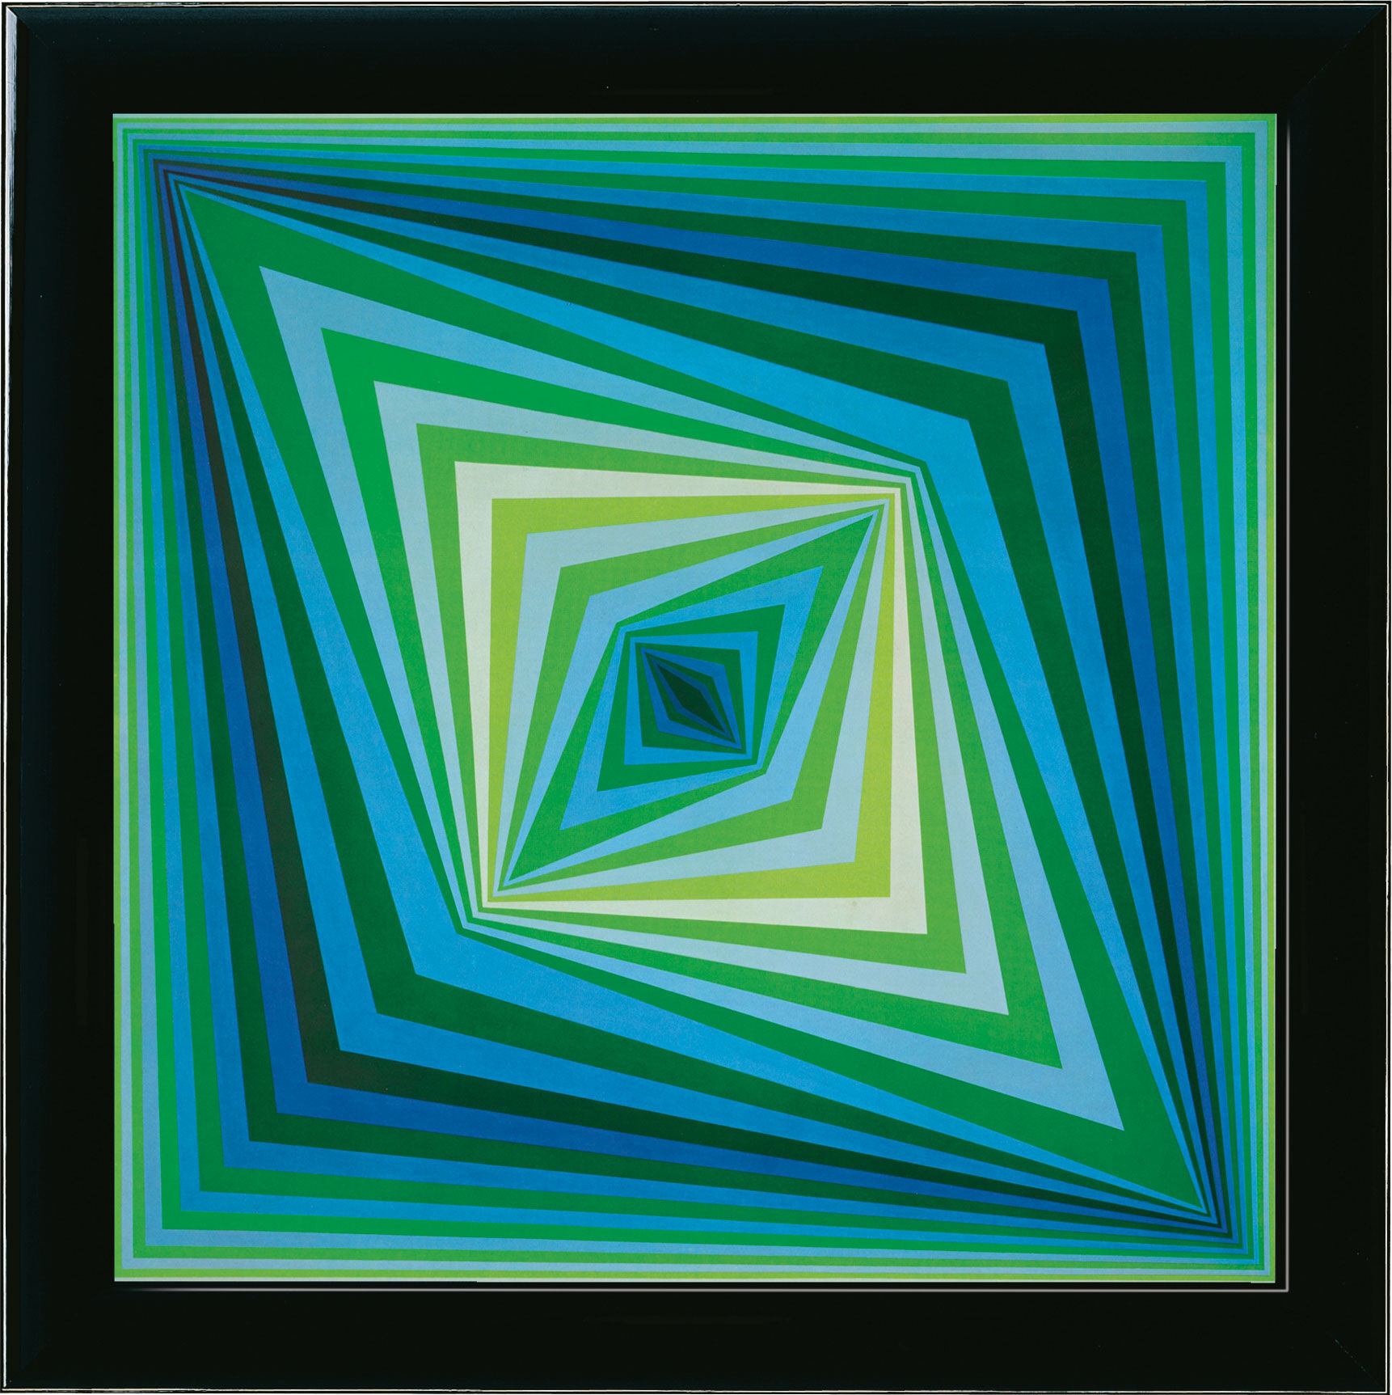
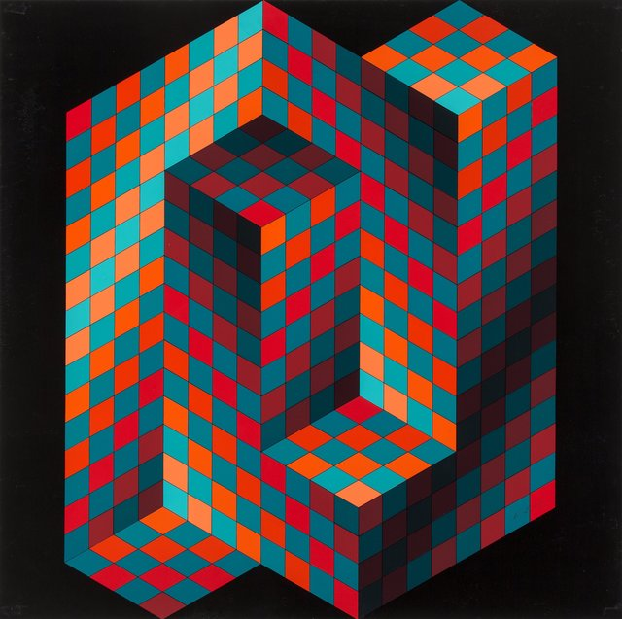
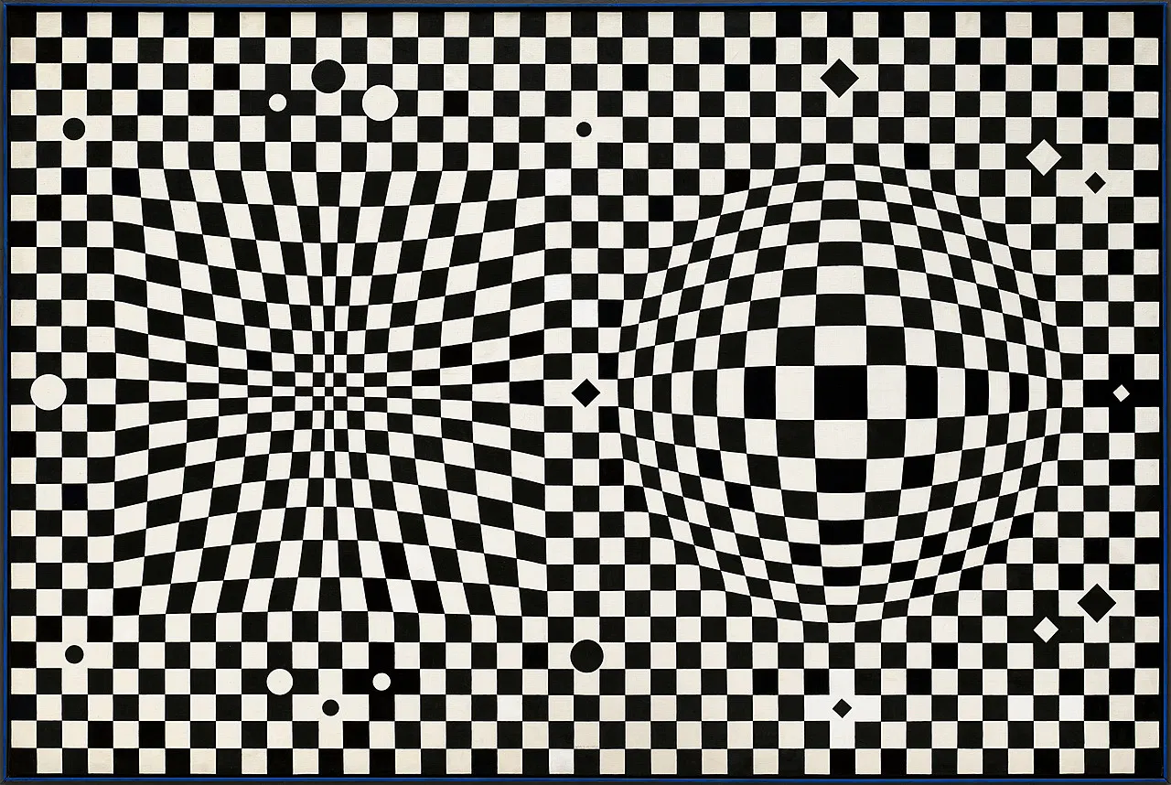
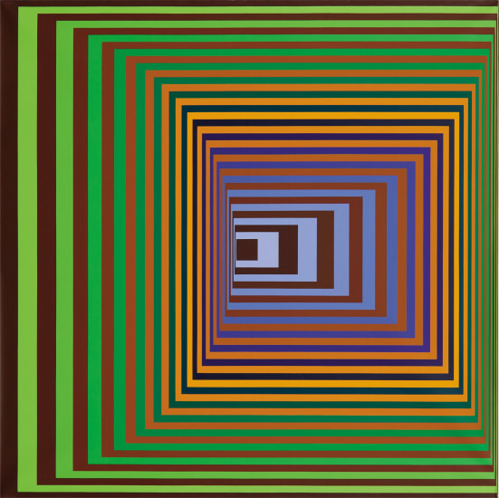
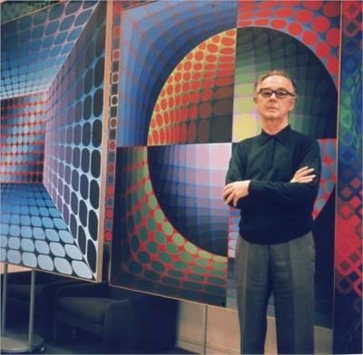
Victor Vasarely
Op Art Artists:
https://www.tate.org.uk/art/artists/victor-vasarely-2095

Slide 6
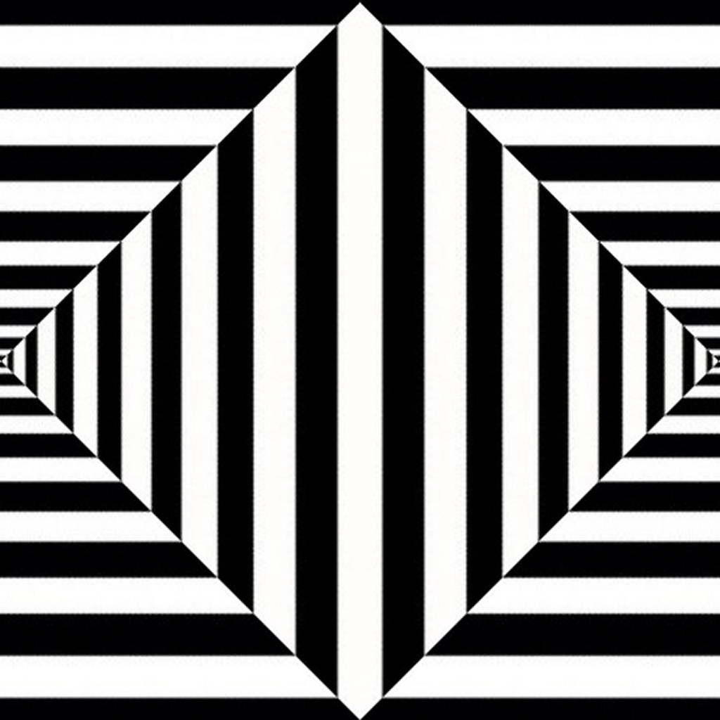
Your OP Art assignment: Create an OP art design. Look at the handouts attached to the assignment in google classroom or look at the images in this powerpoint to get some ideas for your OP art. Here are just 2 of the hundreds of youtube videos you can watch for inspiration (or directions on how to make them)
https://www.youtube.com/watch?v=uuOQoxr2PyQ
https://www.youtube.com/watch?time_continue=274&v=C-ZiFF5EiTU&feature=emb_logo

Slide 7
Just for fun:
The next few slides are just to have fun looking at more optical illusions.

Slide 8
Hermann Grid Illusion
Do you see the black dots?
What happens when you look at one of the dots?

Slide 9
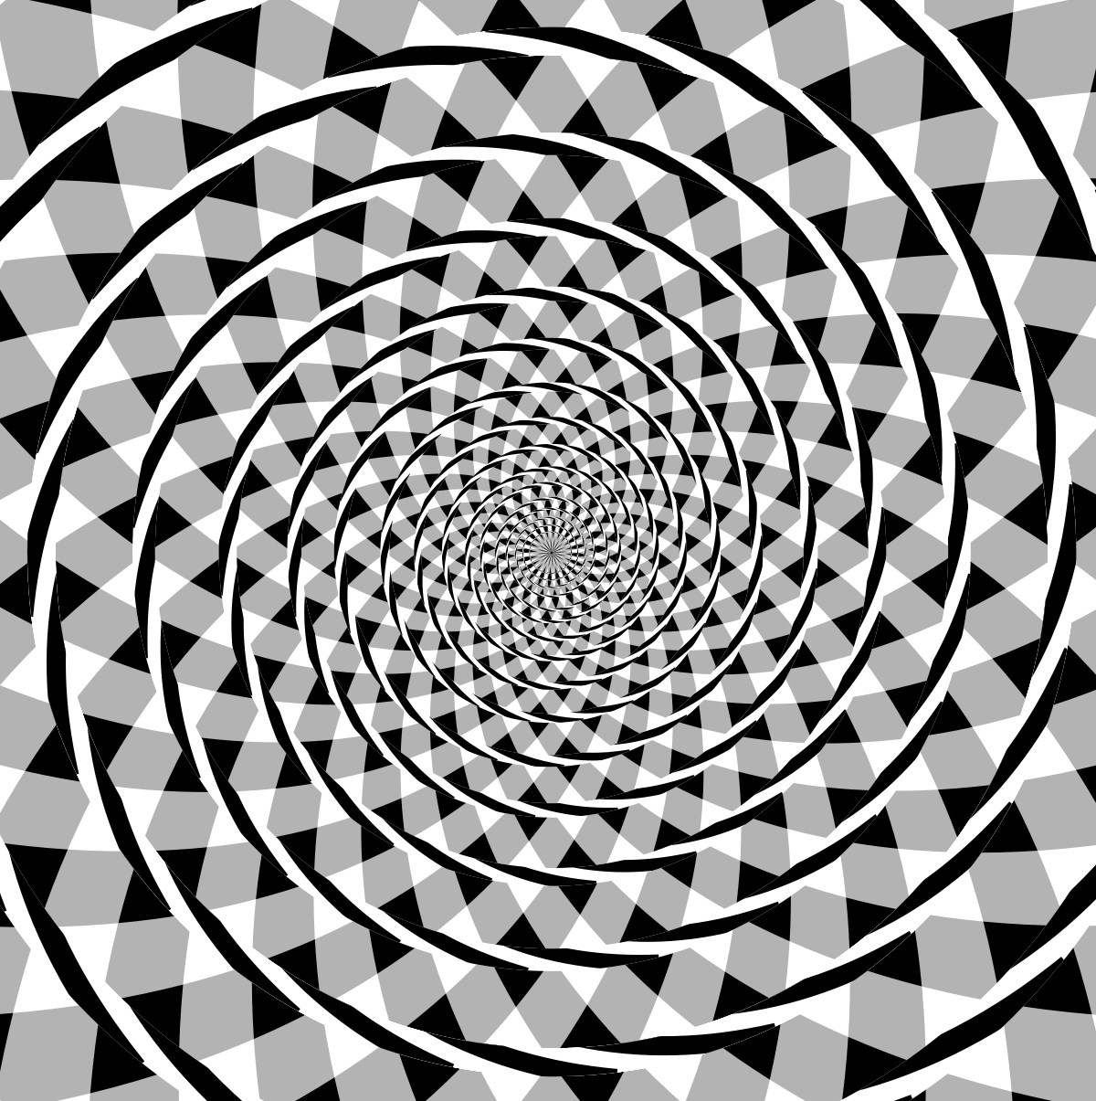
Fraser spiral
It looks like a spiral, but it is really concentric circles (circles with the same center point).

Slide 10
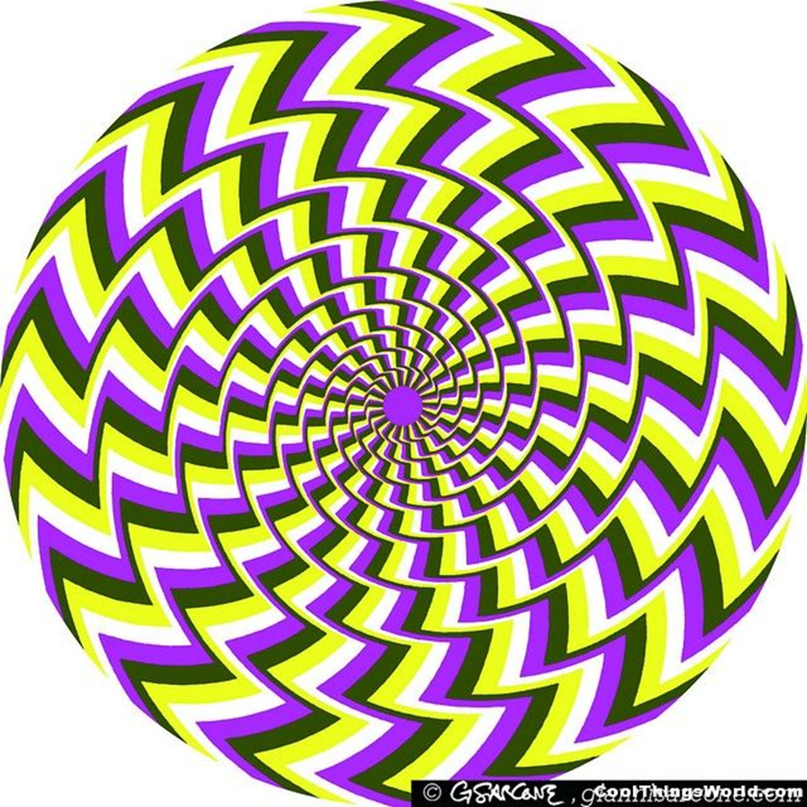
Whoa!
This is not a video.
The turning movement is an optical illusion
You can make it stop by looking at one line.

Slide 11
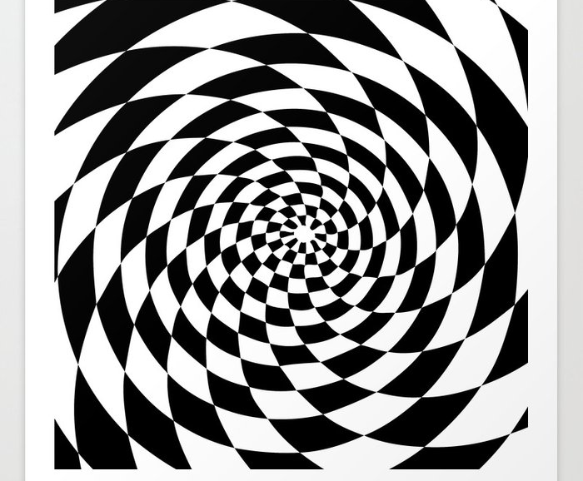
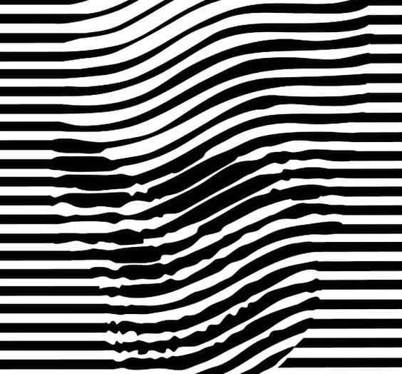
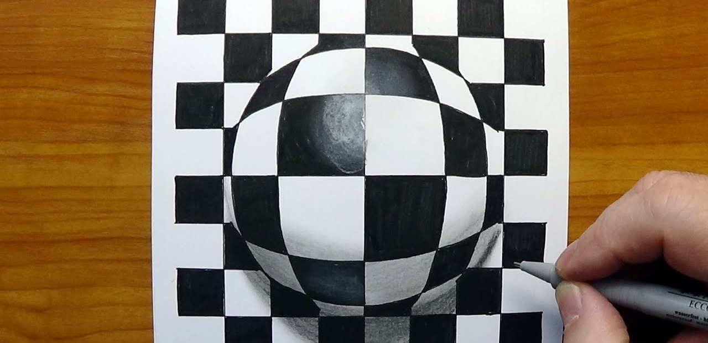
Have fun making your own OP Art optical illusions!

