Slide 1
Expressive Portraiture
DP 1/2

Slide 2
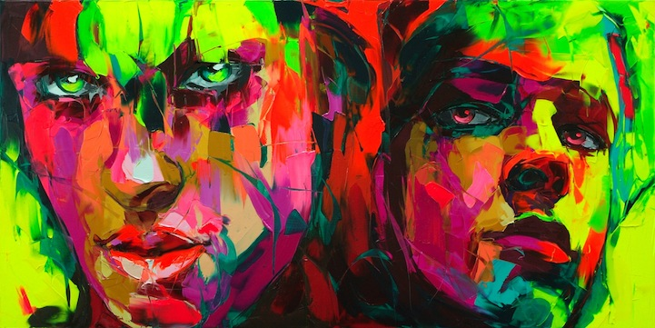
Nielly Francoise French knife painter who uses thick paint and vibrant colors to convey strong emotion

Slide 4
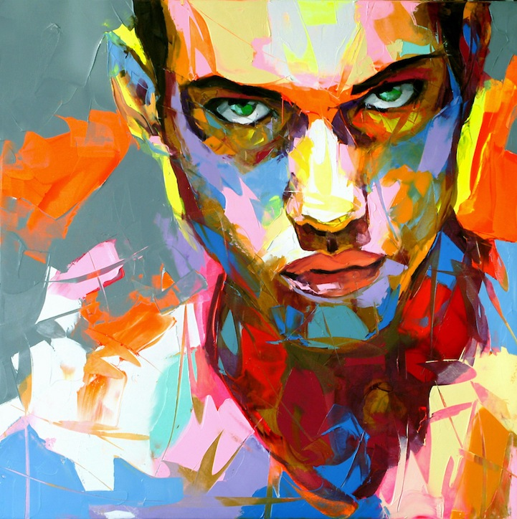

Slide 5
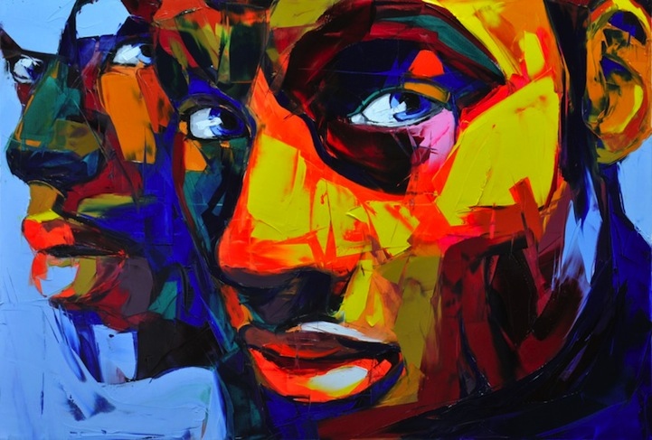

Slide 6
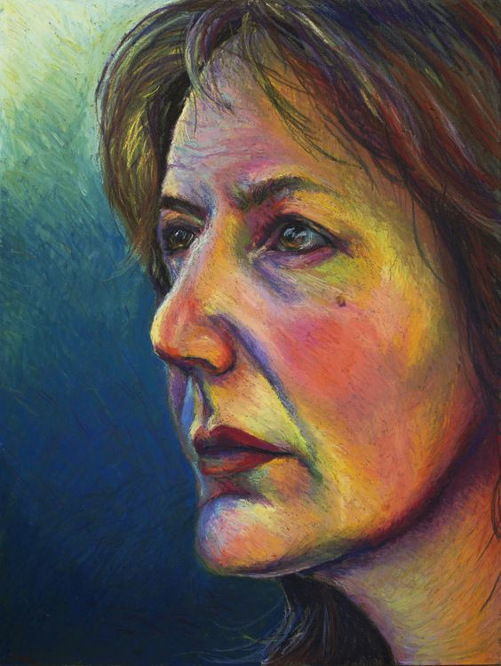
Oil Pastel Color Harmonies
Complementary
*These are color dominant harmonies. You will use many different colors to achieve these effects

Slide 7
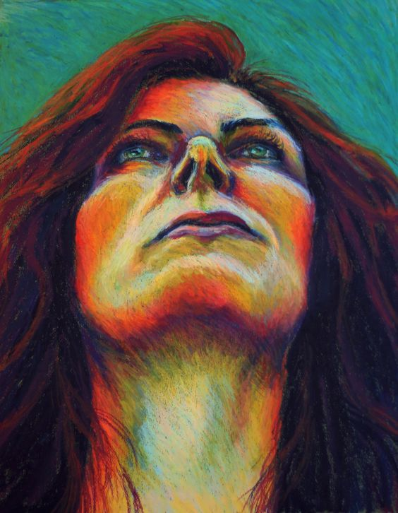
Triatic

Slide 8
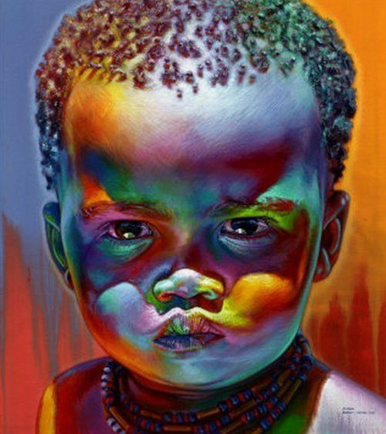
High Contrast

Slide 9
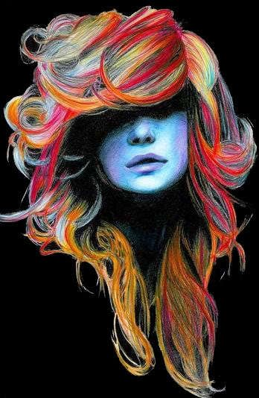
Analogous
Warm and Cool

Slide 10
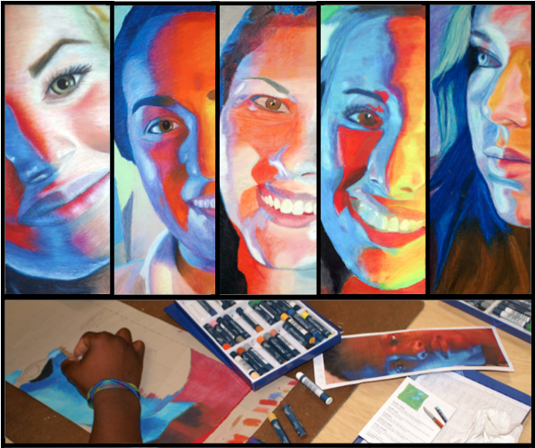
The Process
Strong expression
Filtered Lighting
Photo Reference
Grid Format

Slide 11
WWOil Pastel Application

Slide 13
KEY CONCEPTS
Graphite + Oil = Muddy Color (erase your grid and lighten your contour lines)
Block 1st color in slowly…pay close attention to mid-tone (consider using a flesh tone)
Value trumps color (play with color all you want but stay true to value structure on the black and white copy)
To TEXTURIZE or NOT TO TEXTURIZE, that is the question???
LOR!!!

Slide 18
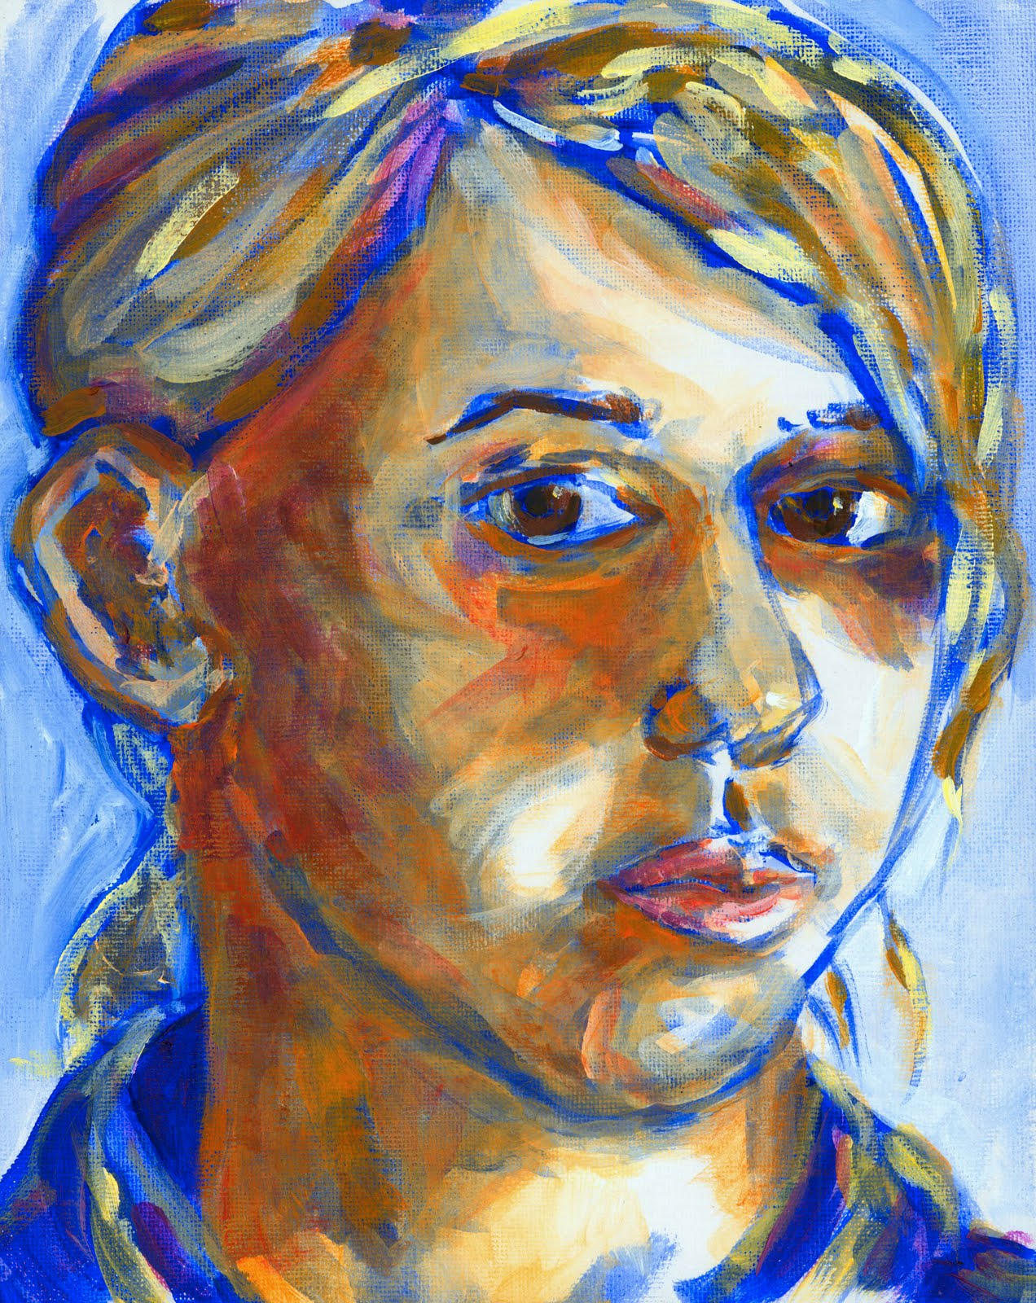

Slide 19
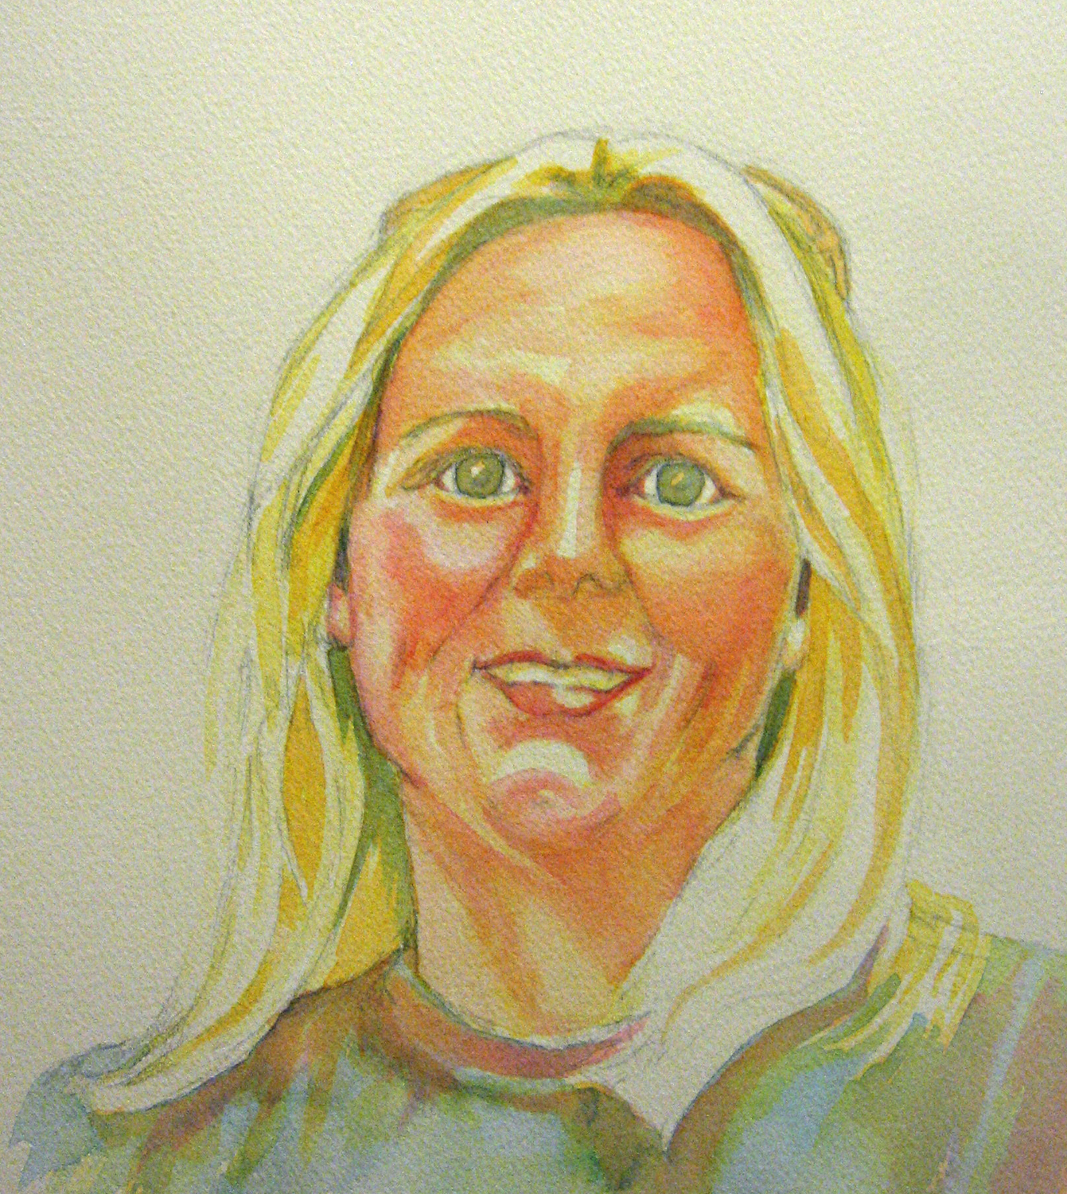

Slide 20
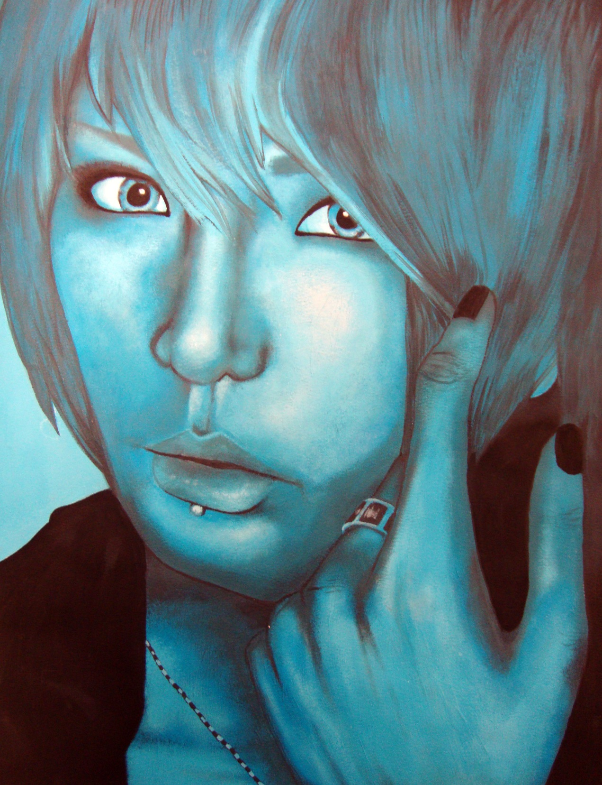

Slide 22
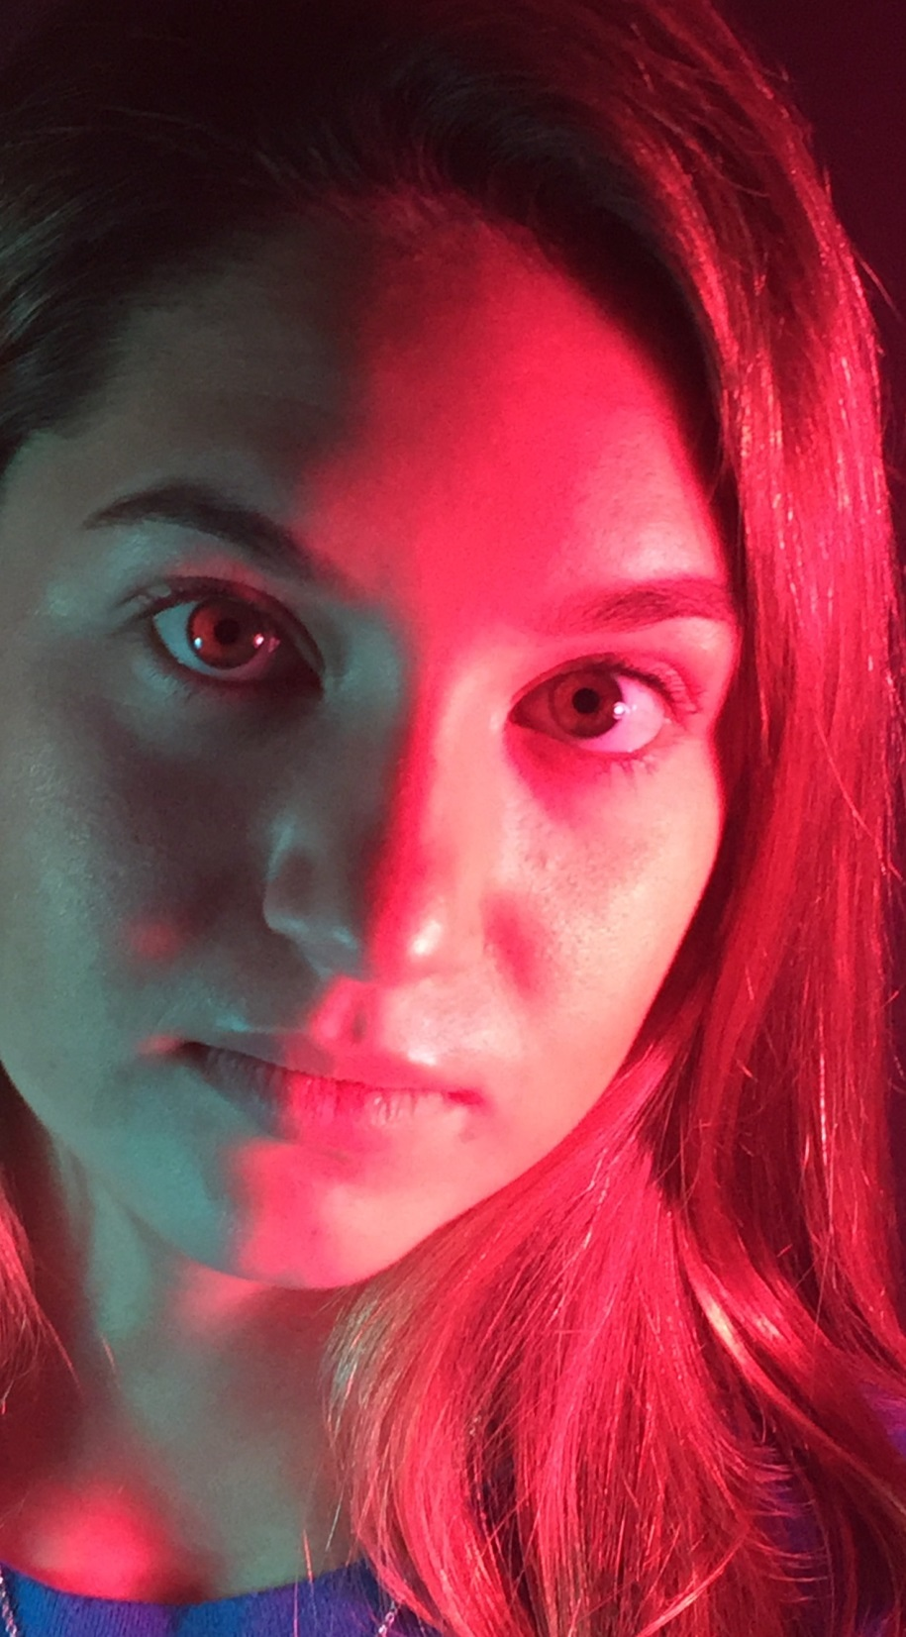
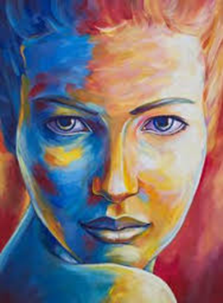

Slide 24
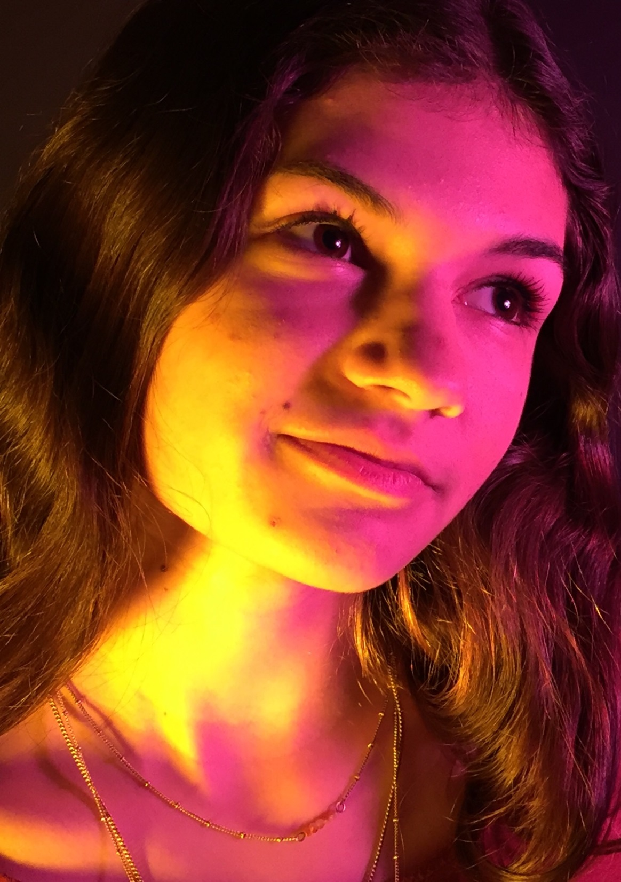

Slide 25
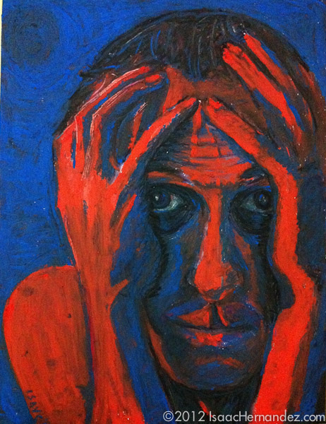

Slide 26
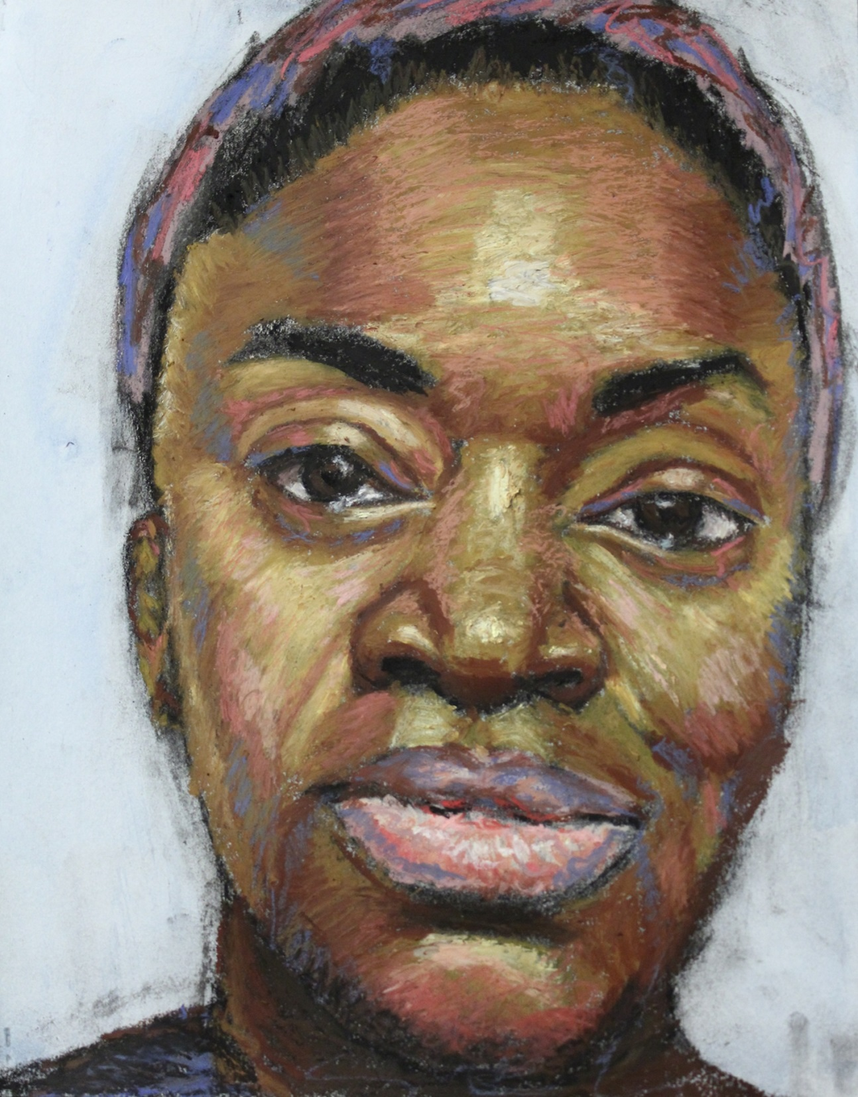

Slide 28
