Slide 1
Activity 3.2
Instant Challenge
Paper Bridge
2 day challenge, take photos, record in engineering notebook, follow design process, create a design brief, present group findings on day 3

Slide 2
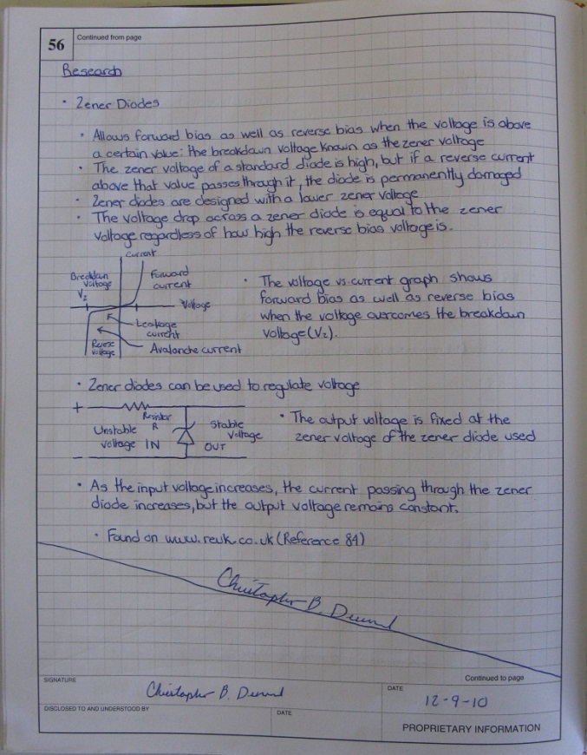
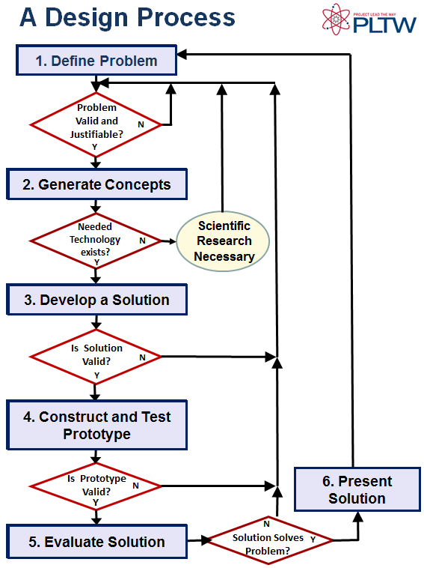
Design Process and Engineering Notebook
Use the engineering design process
Document the steps in your engineering notebook

Slide 3
DDP CALHOUN
Group #1 Jack Zuniga Lise-Anne Orlich Benjamin Kovel | Group #2 Thomas Giannuzzi Sarah Gallagher | Group #3 Samuel Farber Peter Macaluso | Group #4 Hunter Kranmas Jaime Campanelli | Group #5 Brandon Borrelli Arthur Grim
Group #6 Annalisa Zovich Ariel DeJesus | Group #7 Samantha Basile Peter San Gabriel | Group #8 Jack Annibale Ayana Oancea | Group #9 Unice Colon Eric Benz

Slide 4
DDP KENNEDY
Group #1 Max Abramowitz Sam Zavelson | Group #2 David Beigelman David Tamargo | Group #3 Justin Kohan Jason Lehrfeld | Group #4 Scott Fingeroth Jack Adams | Group #5 Joseph Logozzo Calvin Gibson
Group #6 Jacob Schweitzer Jordan Pitti | Group #7 Matthew Yeh Joshua Trook | Group #8 Dylan Kliers Andrew Bo | Group #9 Corey Levy Marco Travaglione

Slide 5
Day 1
Complete Deep Dive Design Brief to be handed in.
Overview Paper Bridge Activity as a class
Step 1: Define the problem
Create Design Brief in Engineer’s Notebook.
Research and Generate ideas. (Computer?)
Begin documenting Design Process in Engineer’s notebook

Slide 6
Day 1
1. Define the Problem
Everyone label and begin DESIGN BRIEF.
Title the Page
Client
End User
Designer(s)
Problem Statement: What is the problem trying to be solved? Complete sentences
Design Statement: To what degree is the solution to be realized? Design etc. etc.
Now, document the rest of the design process…
Break into Groups…

Slide 7
Day 2
Build your bridges!
Document your process!
Test, photograph, measure, redesign!

Slide 8
Day 3
Continue building bridges!
BUILD, TEST, MEASURE, PHOTOGRAPH, REDESIGN, REPEAT!
Document your work step by step
Day 4: Create a presentation of your work. You choose (PPT, Google Slides, Presi, Video etc.)
Day 5: ALL groups present to class!

Slide 9
Design Process Documentation
Process will occur quickly
Focus on the process
Refer to Activity Instant Challenge: Paper Bridge

Slide 10
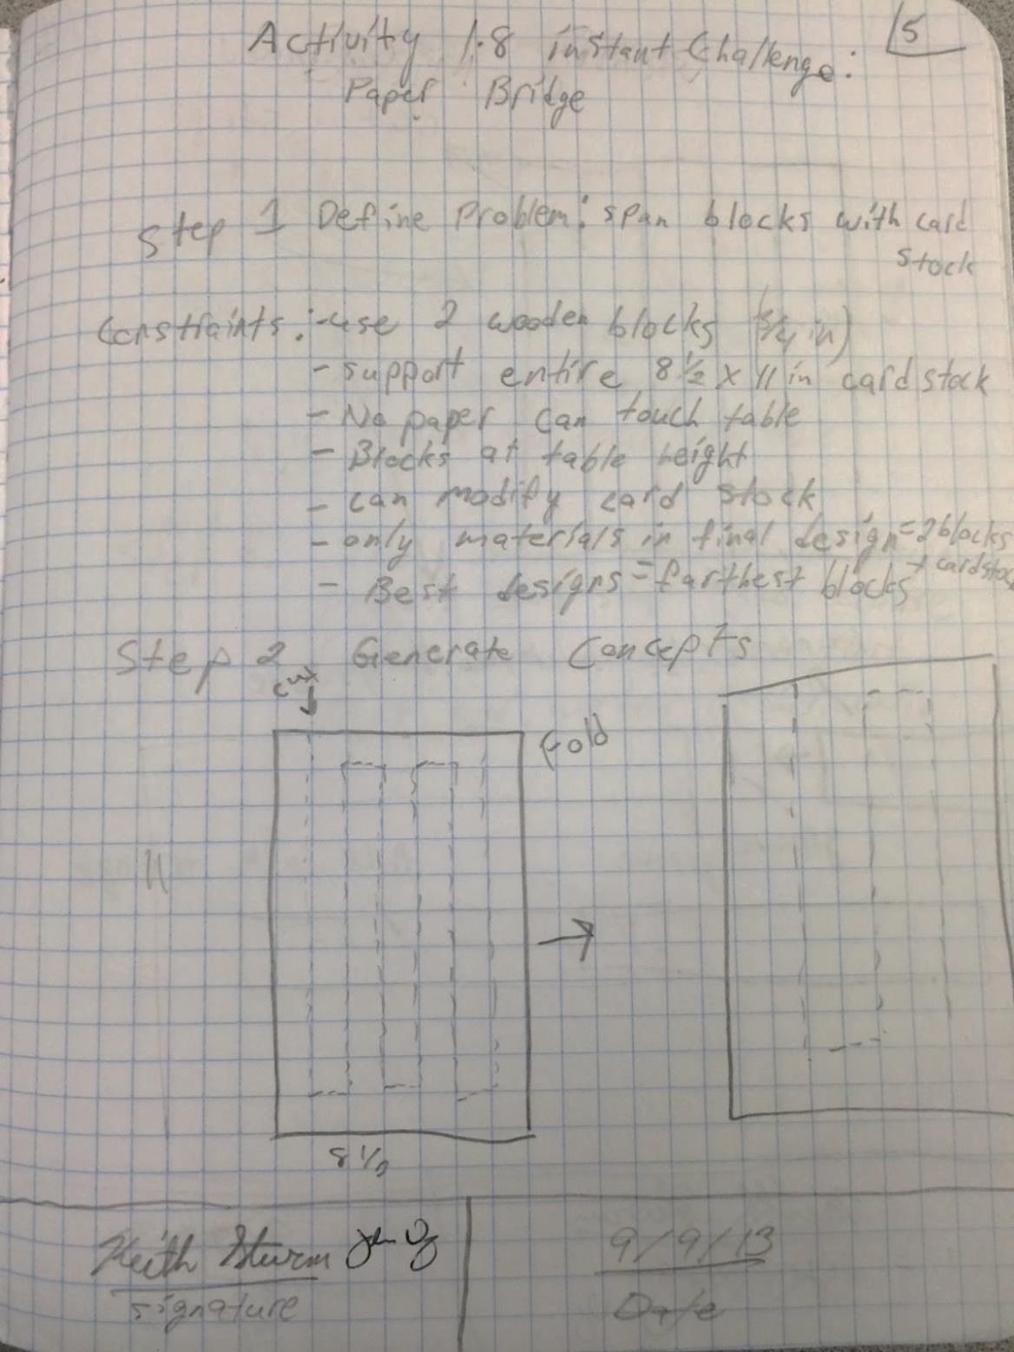

Slide 11
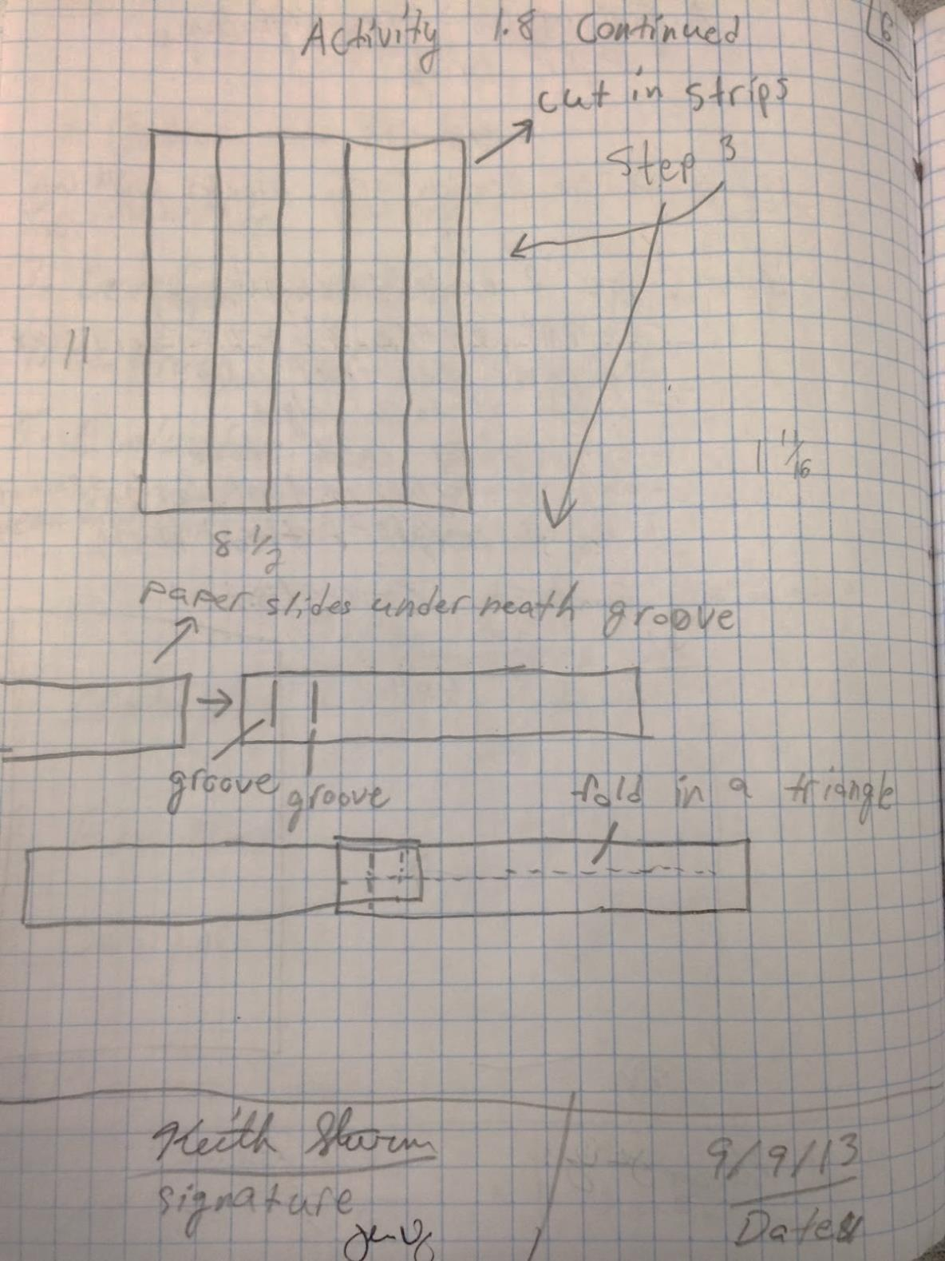

Slide 12
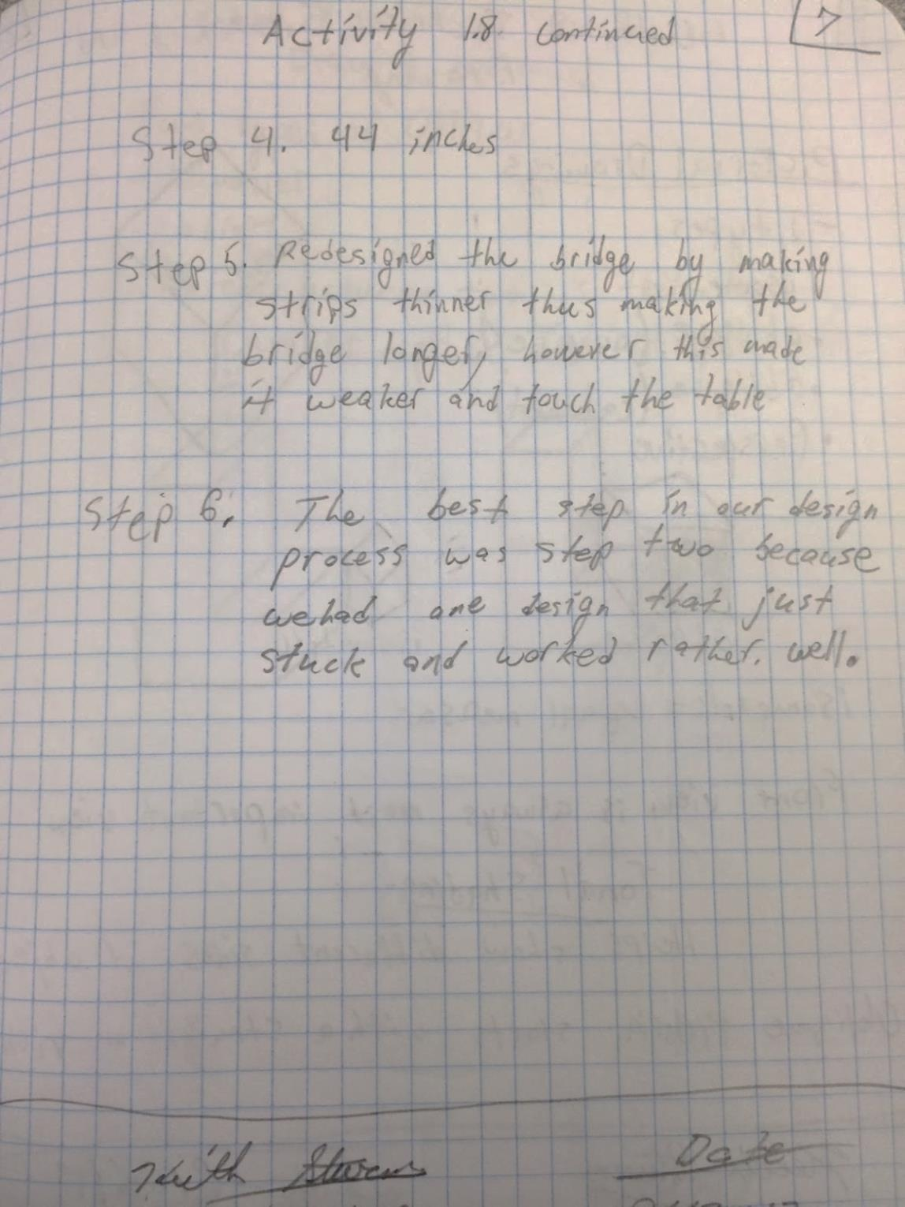

Slide 13
Engineering Notebook: Title
Page number
Short title as reference
Subsequent pages use same title
when working on this project

Slide 14
Engineering Notebook: Define the Problem (1 Minute)
Simple problem statement with no details

Slide 15
Engineering Notebook: Constraints (1 Minute)
aaaa
Constraints listed with values and units

Slide 16
Engineering Notebook: Prior Solution Attempts (2 Minutes)
Document 1-2 website resources
2 minutes to list resources

Slide 17
Engineering Notebook: Prior Solution Attempts (2 Minutes)
Document 1-2 website resources
2 minutes to list resources

Slide 18
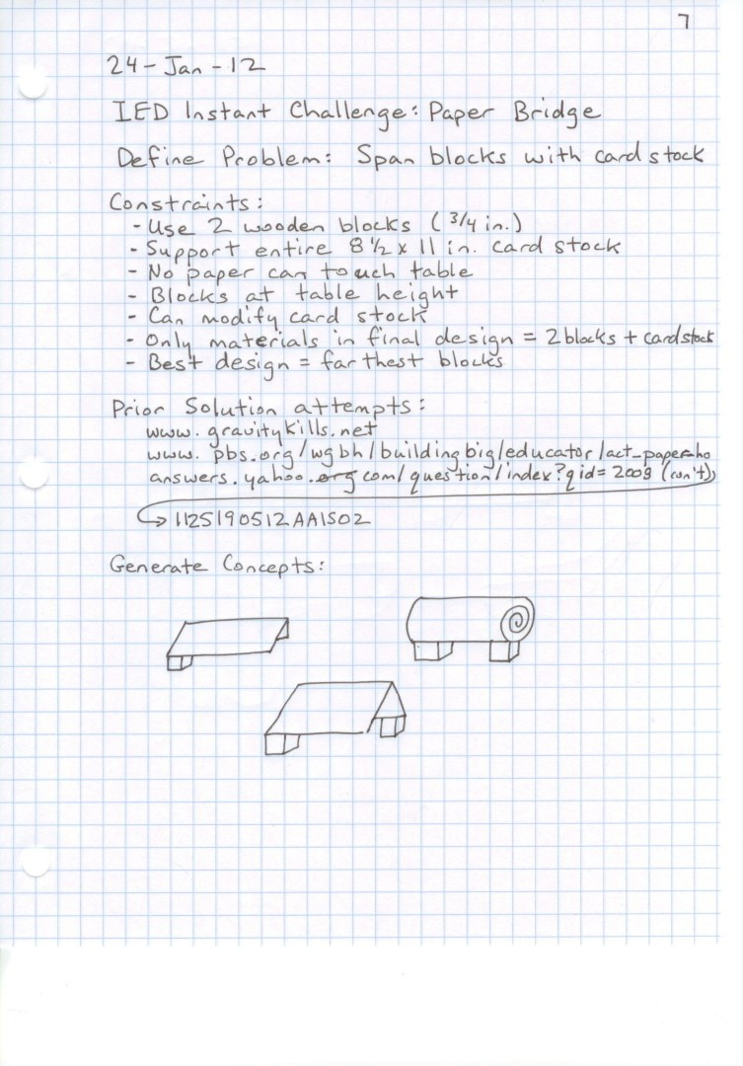
Engineering Notebook: Generate Concepts (2 Minutes)
2 minutes to complete 3 sketches
(In future more time will be given)

Slide 19
Engineering Notebook: Generate Concepts (2 Minutes)
2 minutes to complete 3 sketches

Slide 20
Engineering Notebook: Develop a Solution (2 Minutes)
Choose a concept

Slide 21
Engineering Notebook: Construct and Test Prototype (10 Minutes)
Document what is happening!!!

Slide 22
Engineering Notebook: Evaluate a Solution (1 Minute) How well did it work? Document your thoughts!!!!

Slide 23
Engineering Notebook: Present Solution

Slide 24
Complete Remaining Design Steps
Go back and make sure you have documented every step of the design process clearly in your engineering notebook.

